Slide 1
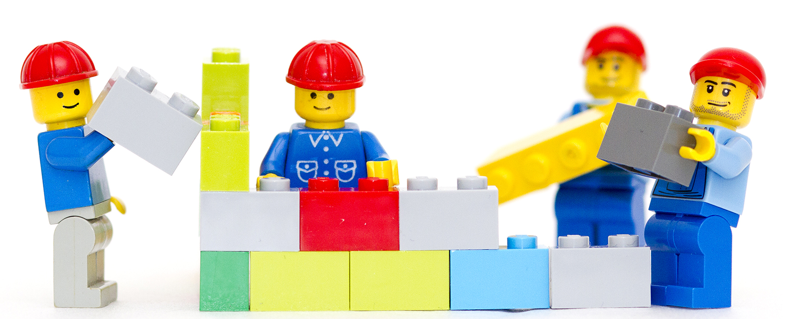
BUILDING NEW Worlds

Slide 2
LAST WeEK

Slide 3


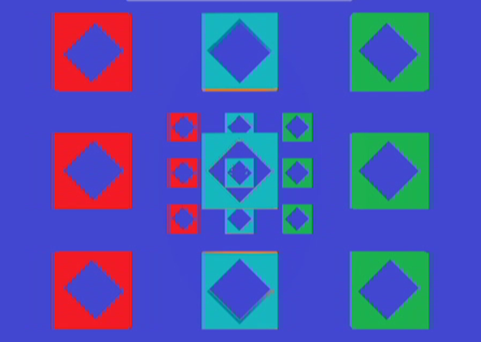
SPEED OF LIGHT

Slide 4
THIS WeEK

Slide 5

Building new world
Last week I build a world in Unity.
This week I decided to augment a physical
space digitally and physically

Slide 6
BUILDING
MATERIALS

Slide 7
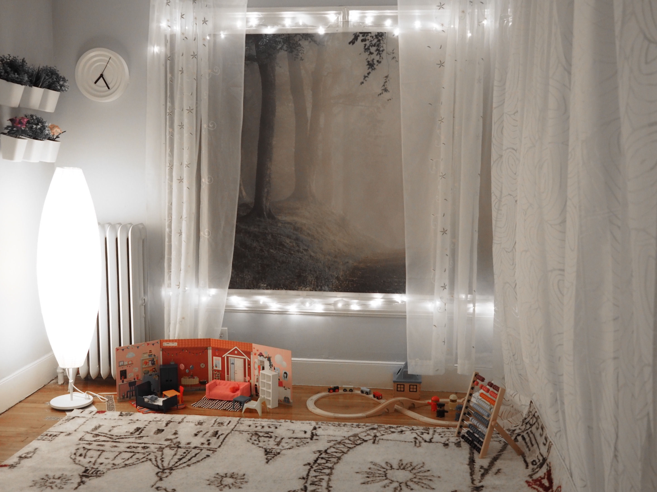
Physical
Augmentation

Slide 8
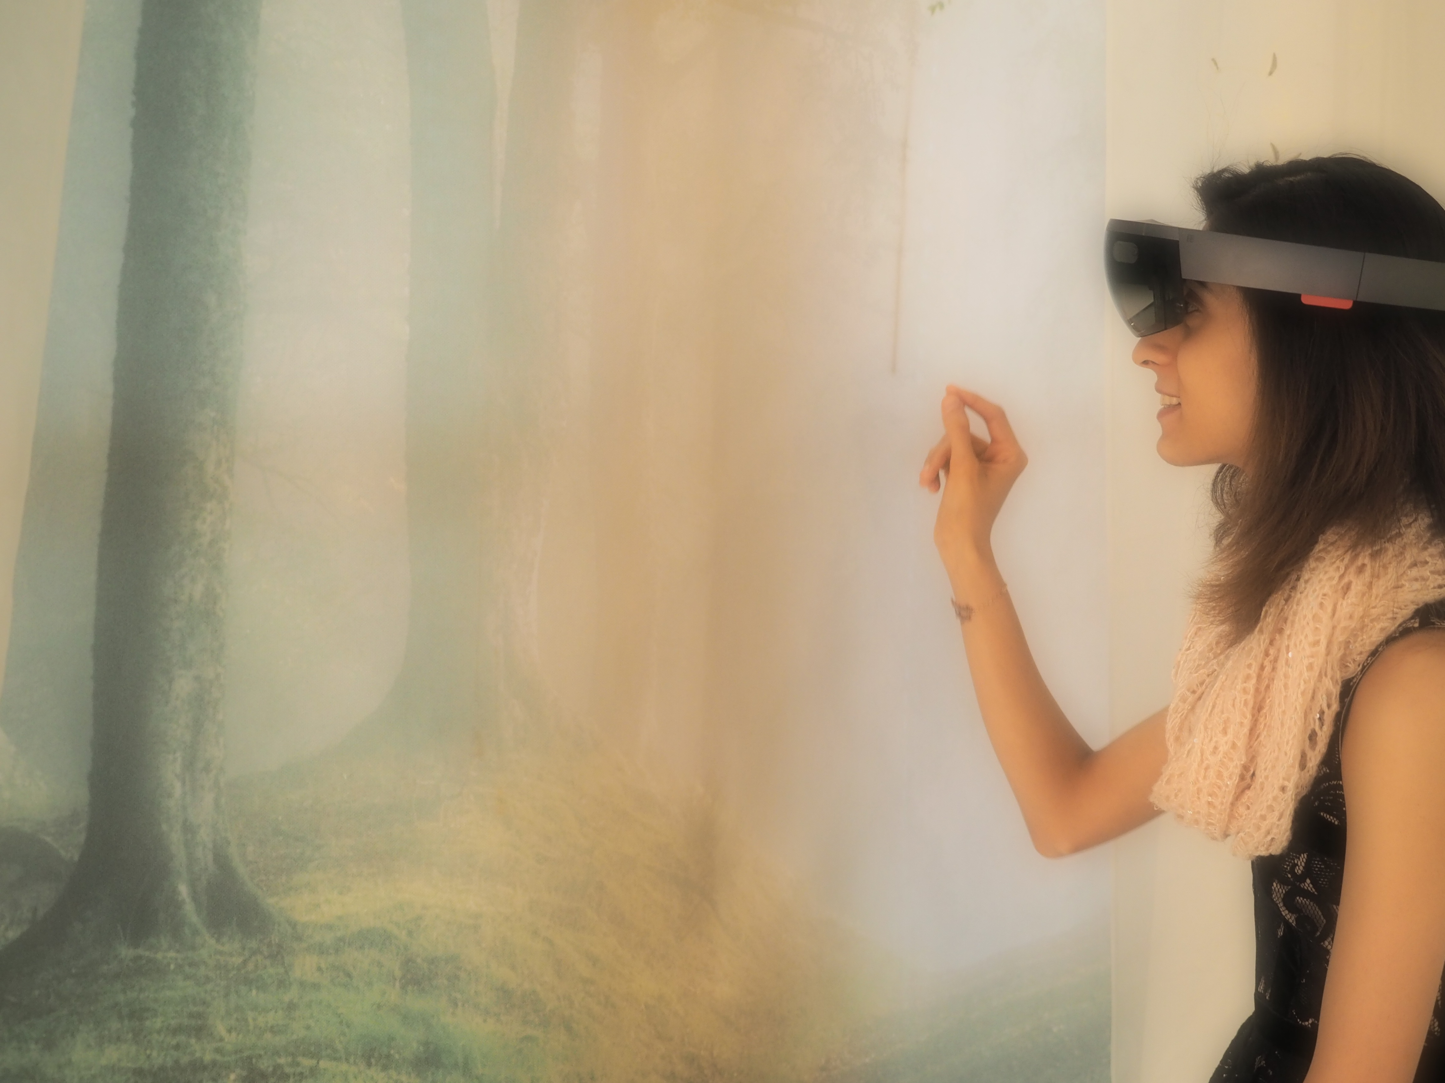

Virtual
Augmentation

Slide 9
ORIGINAL
SPACE

Slide 10
Original Space

Slide 11
NEW
PHYSICAL
SPACE

Slide 12
New Space

Slide 13
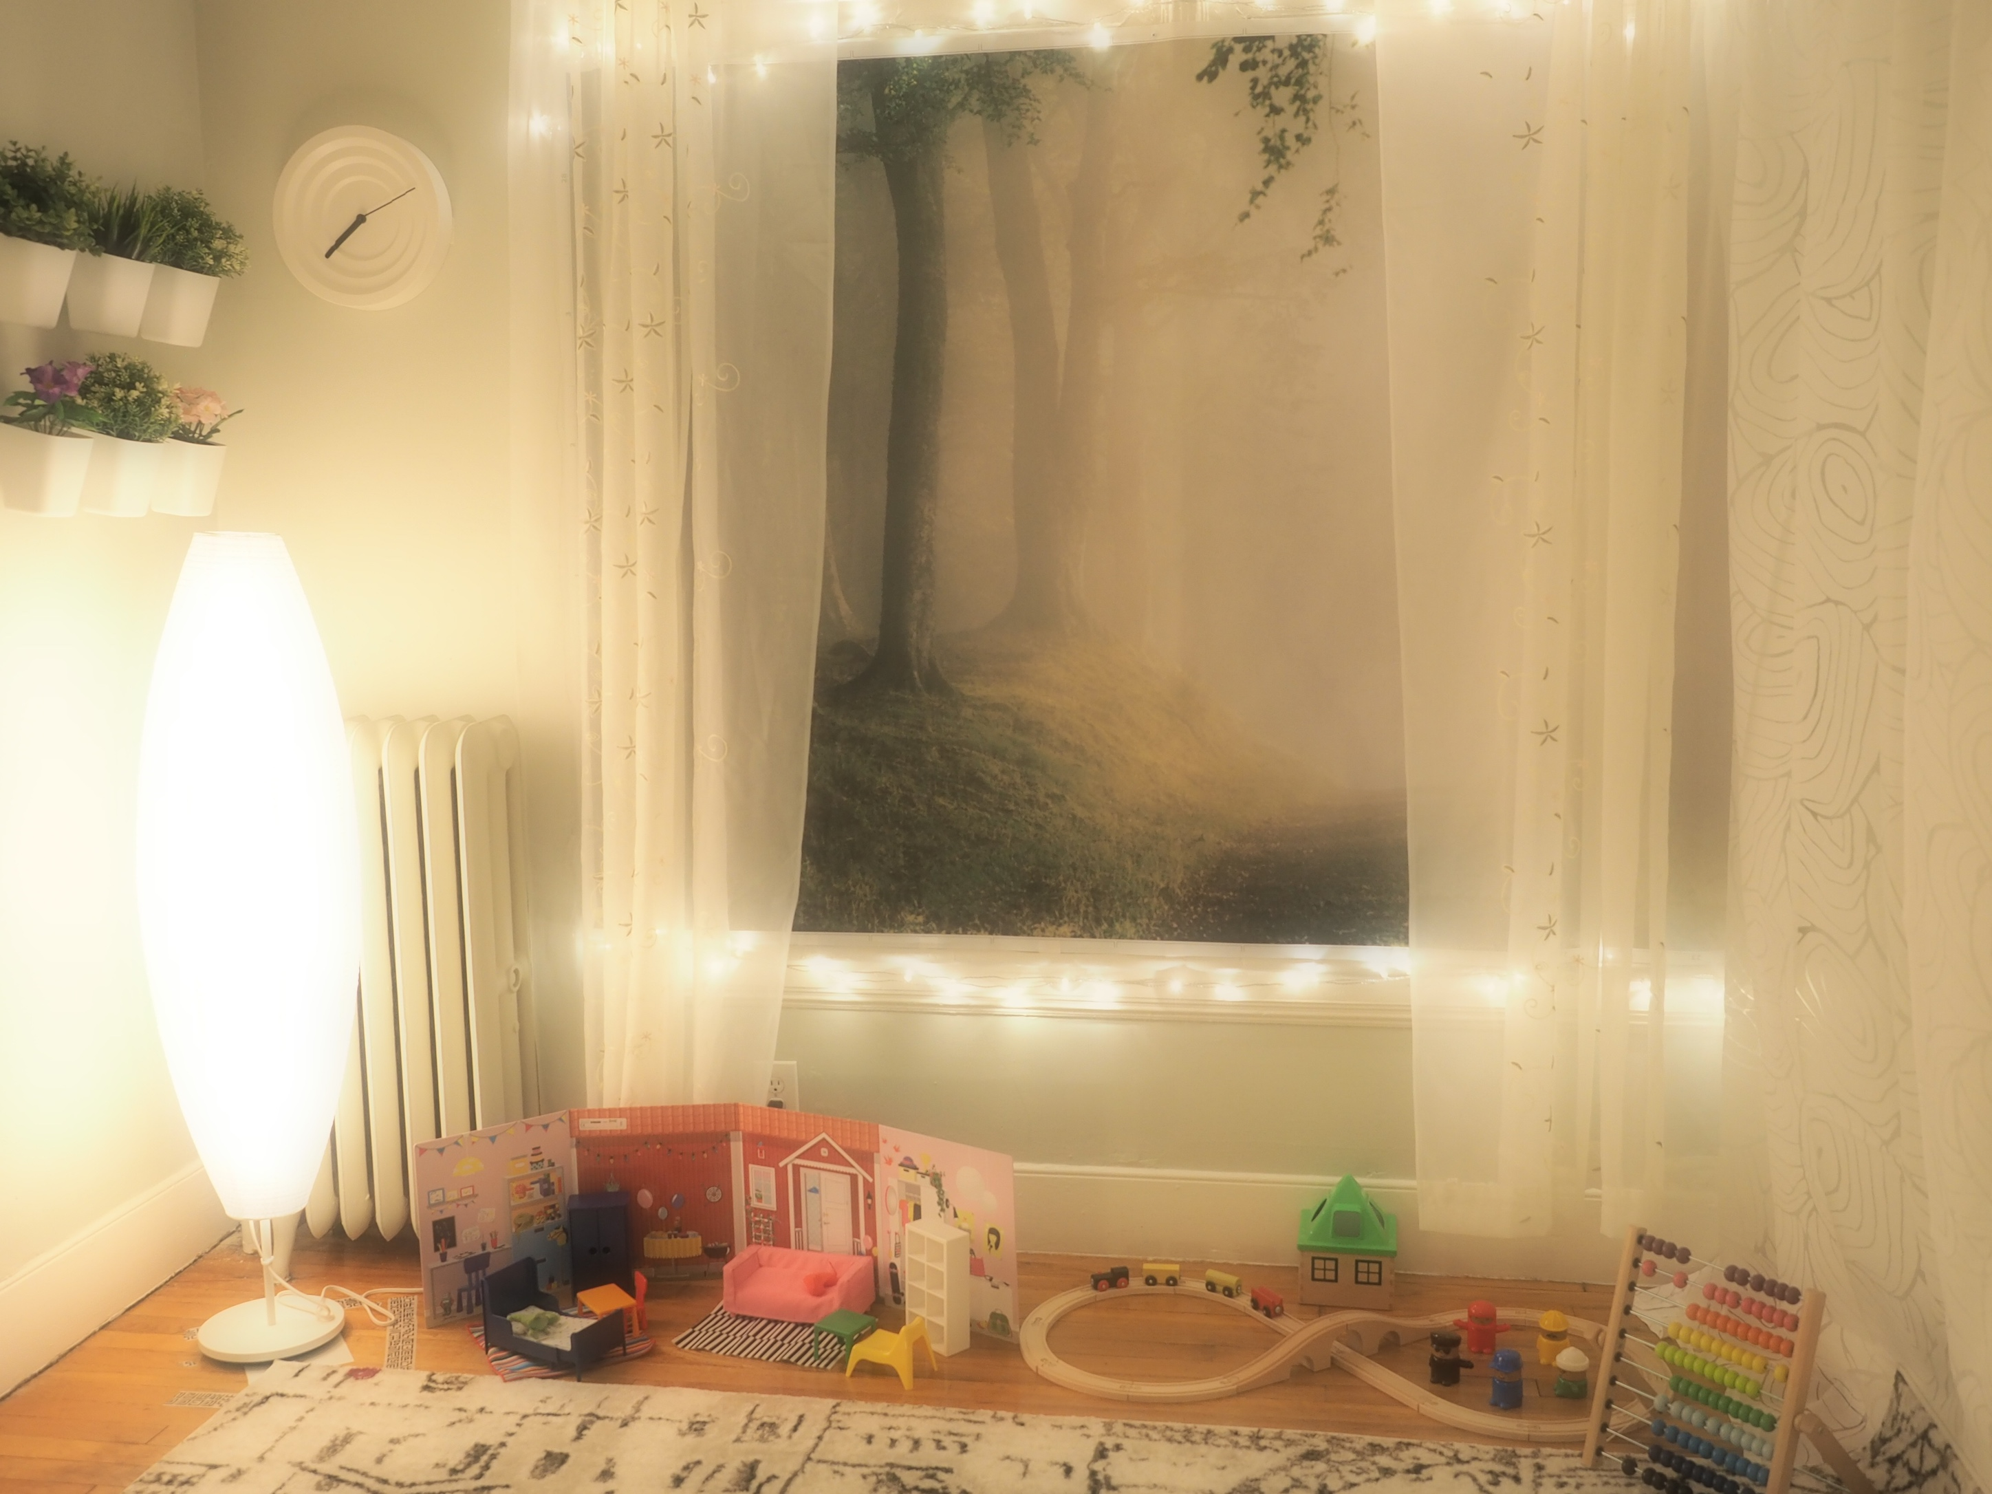
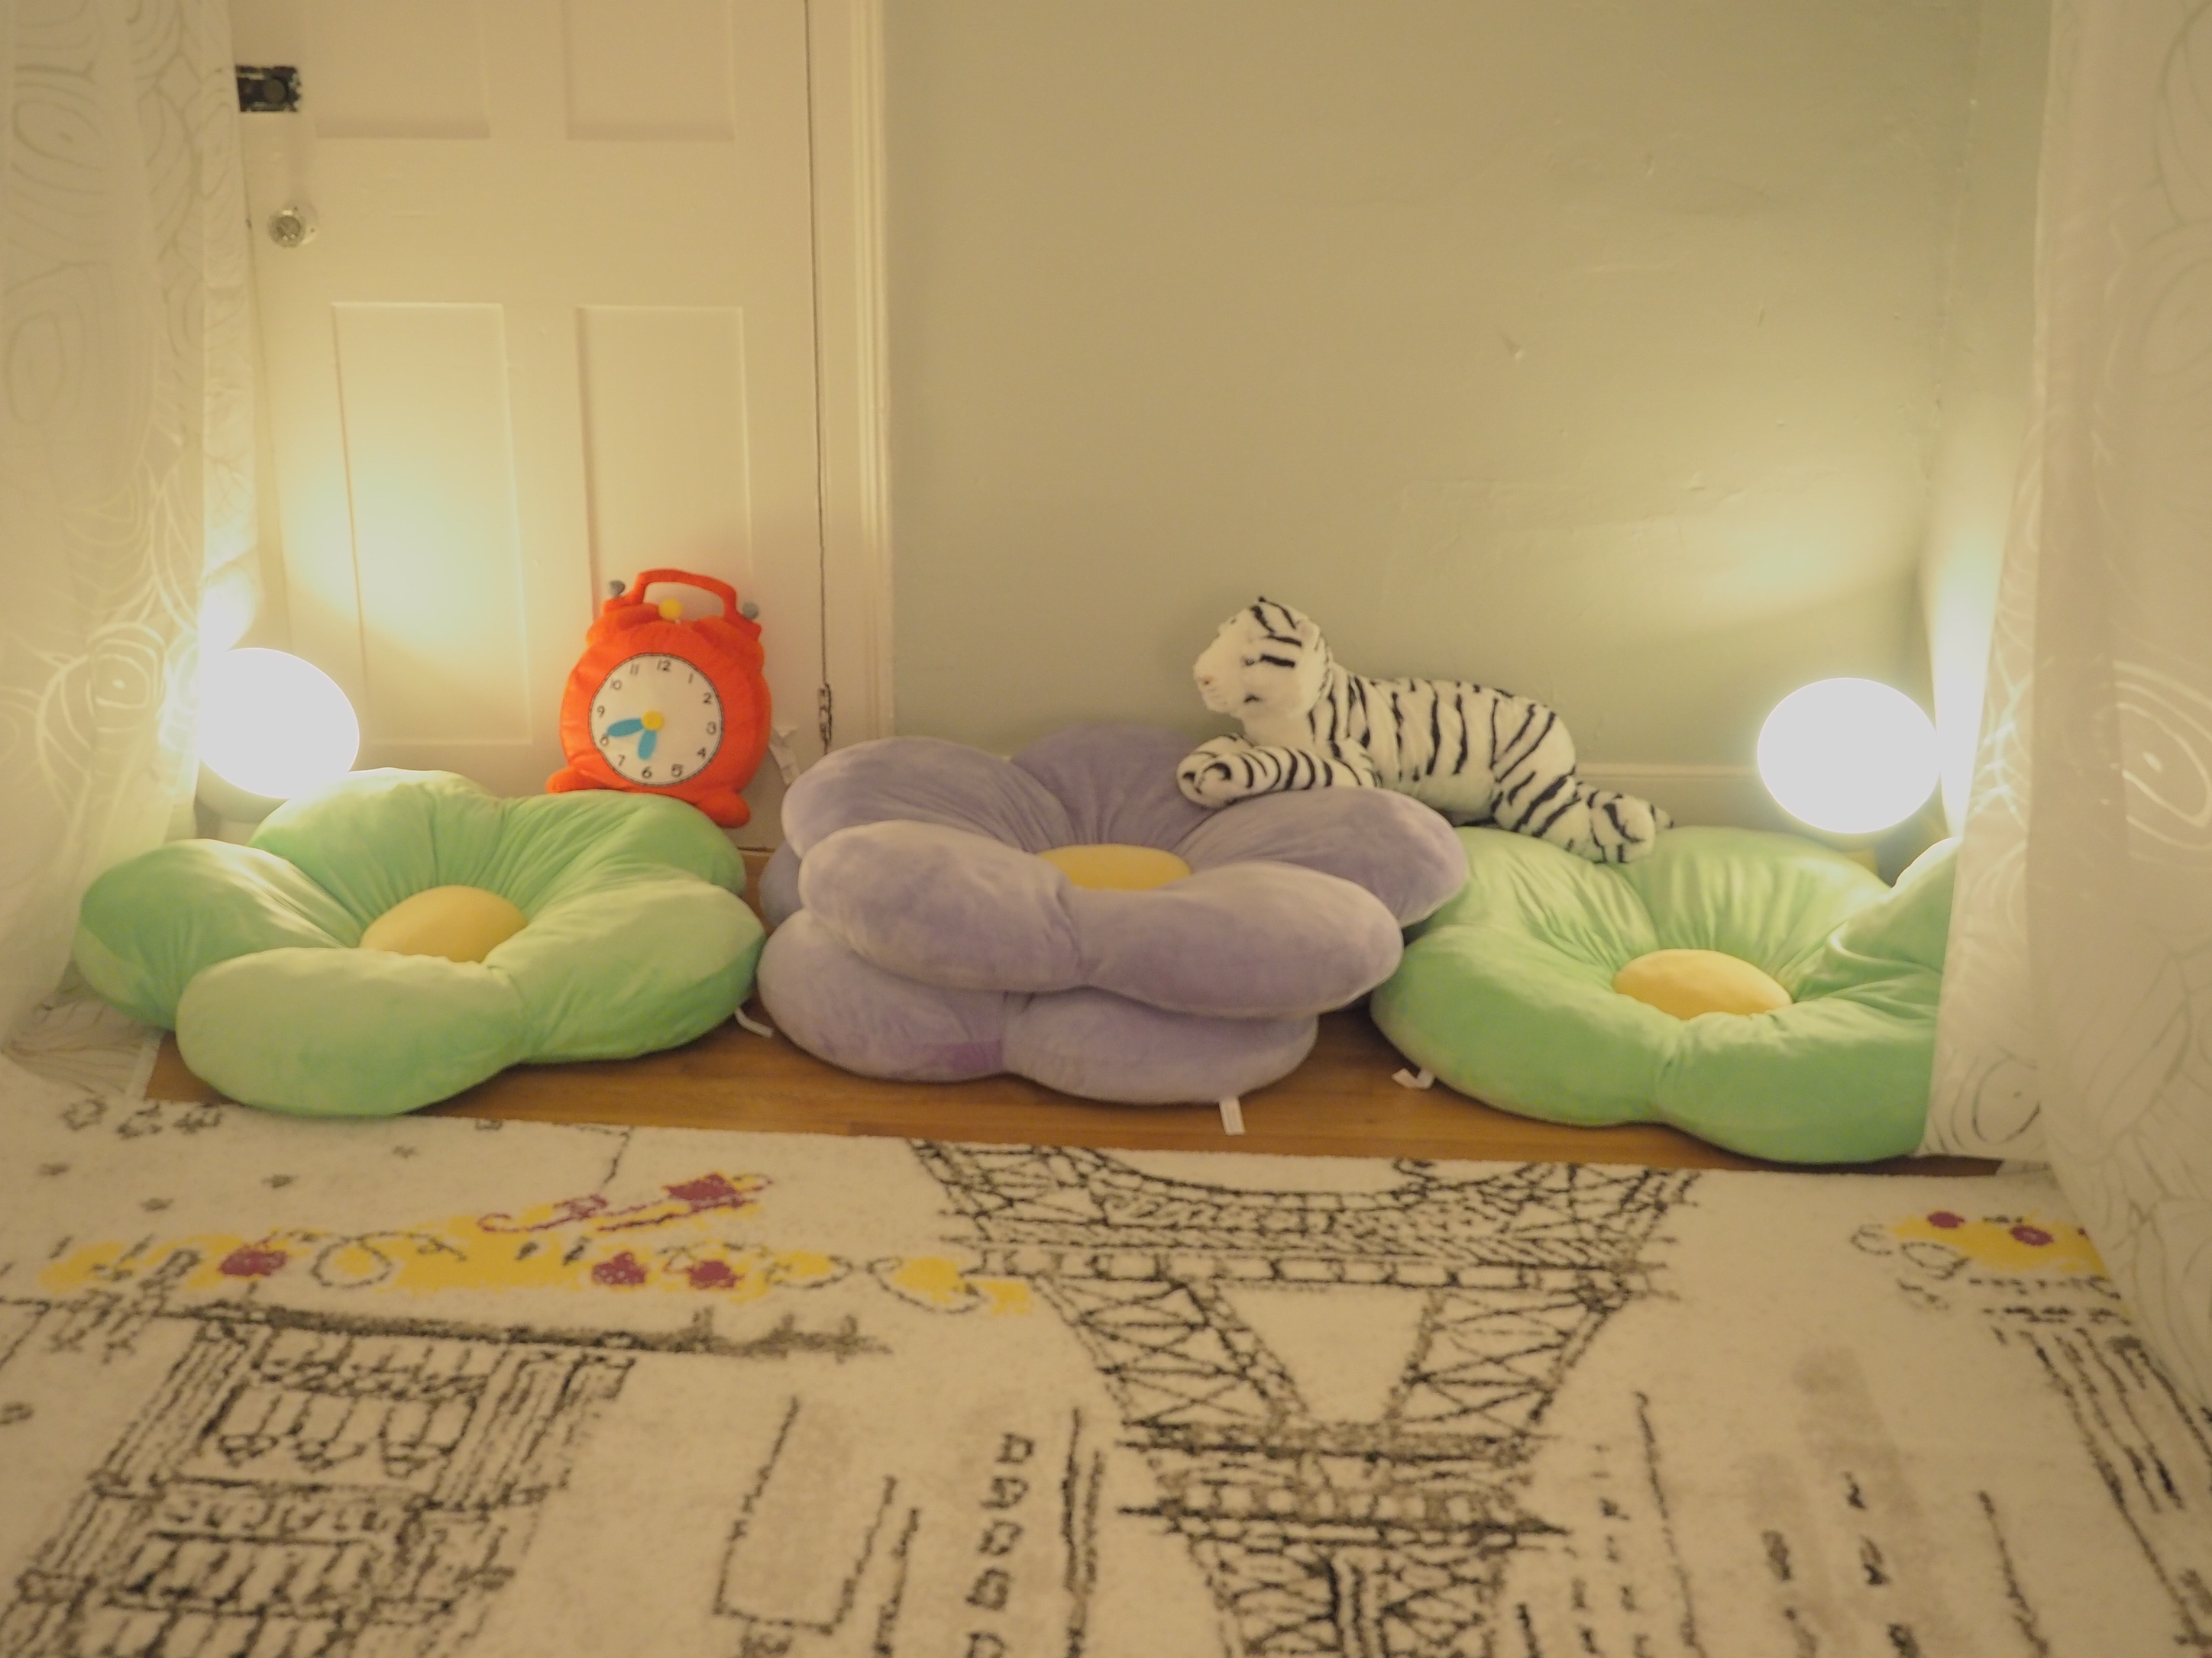
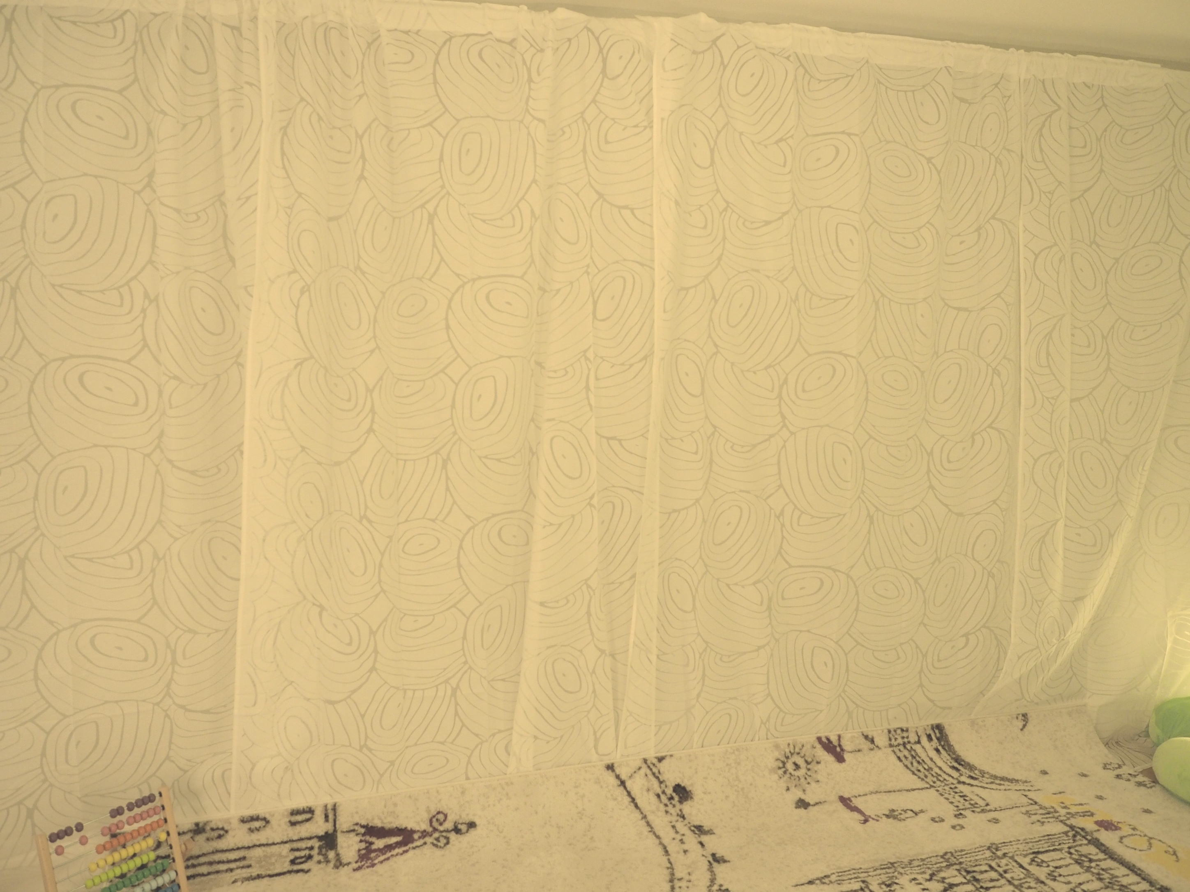
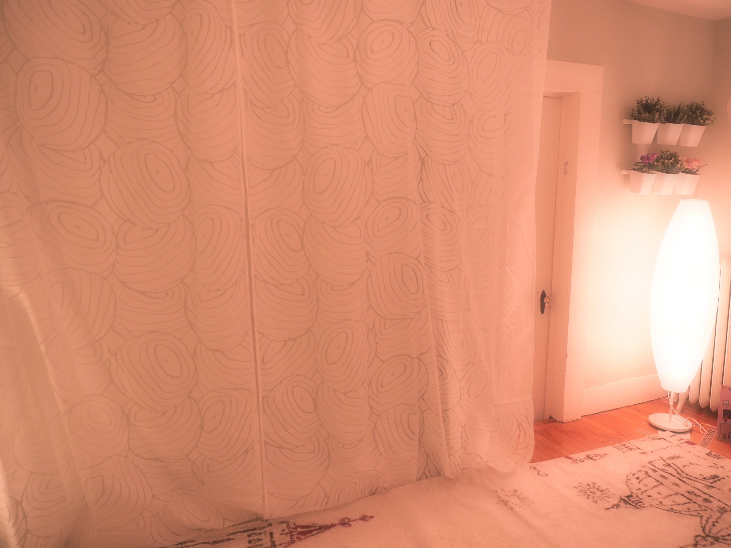
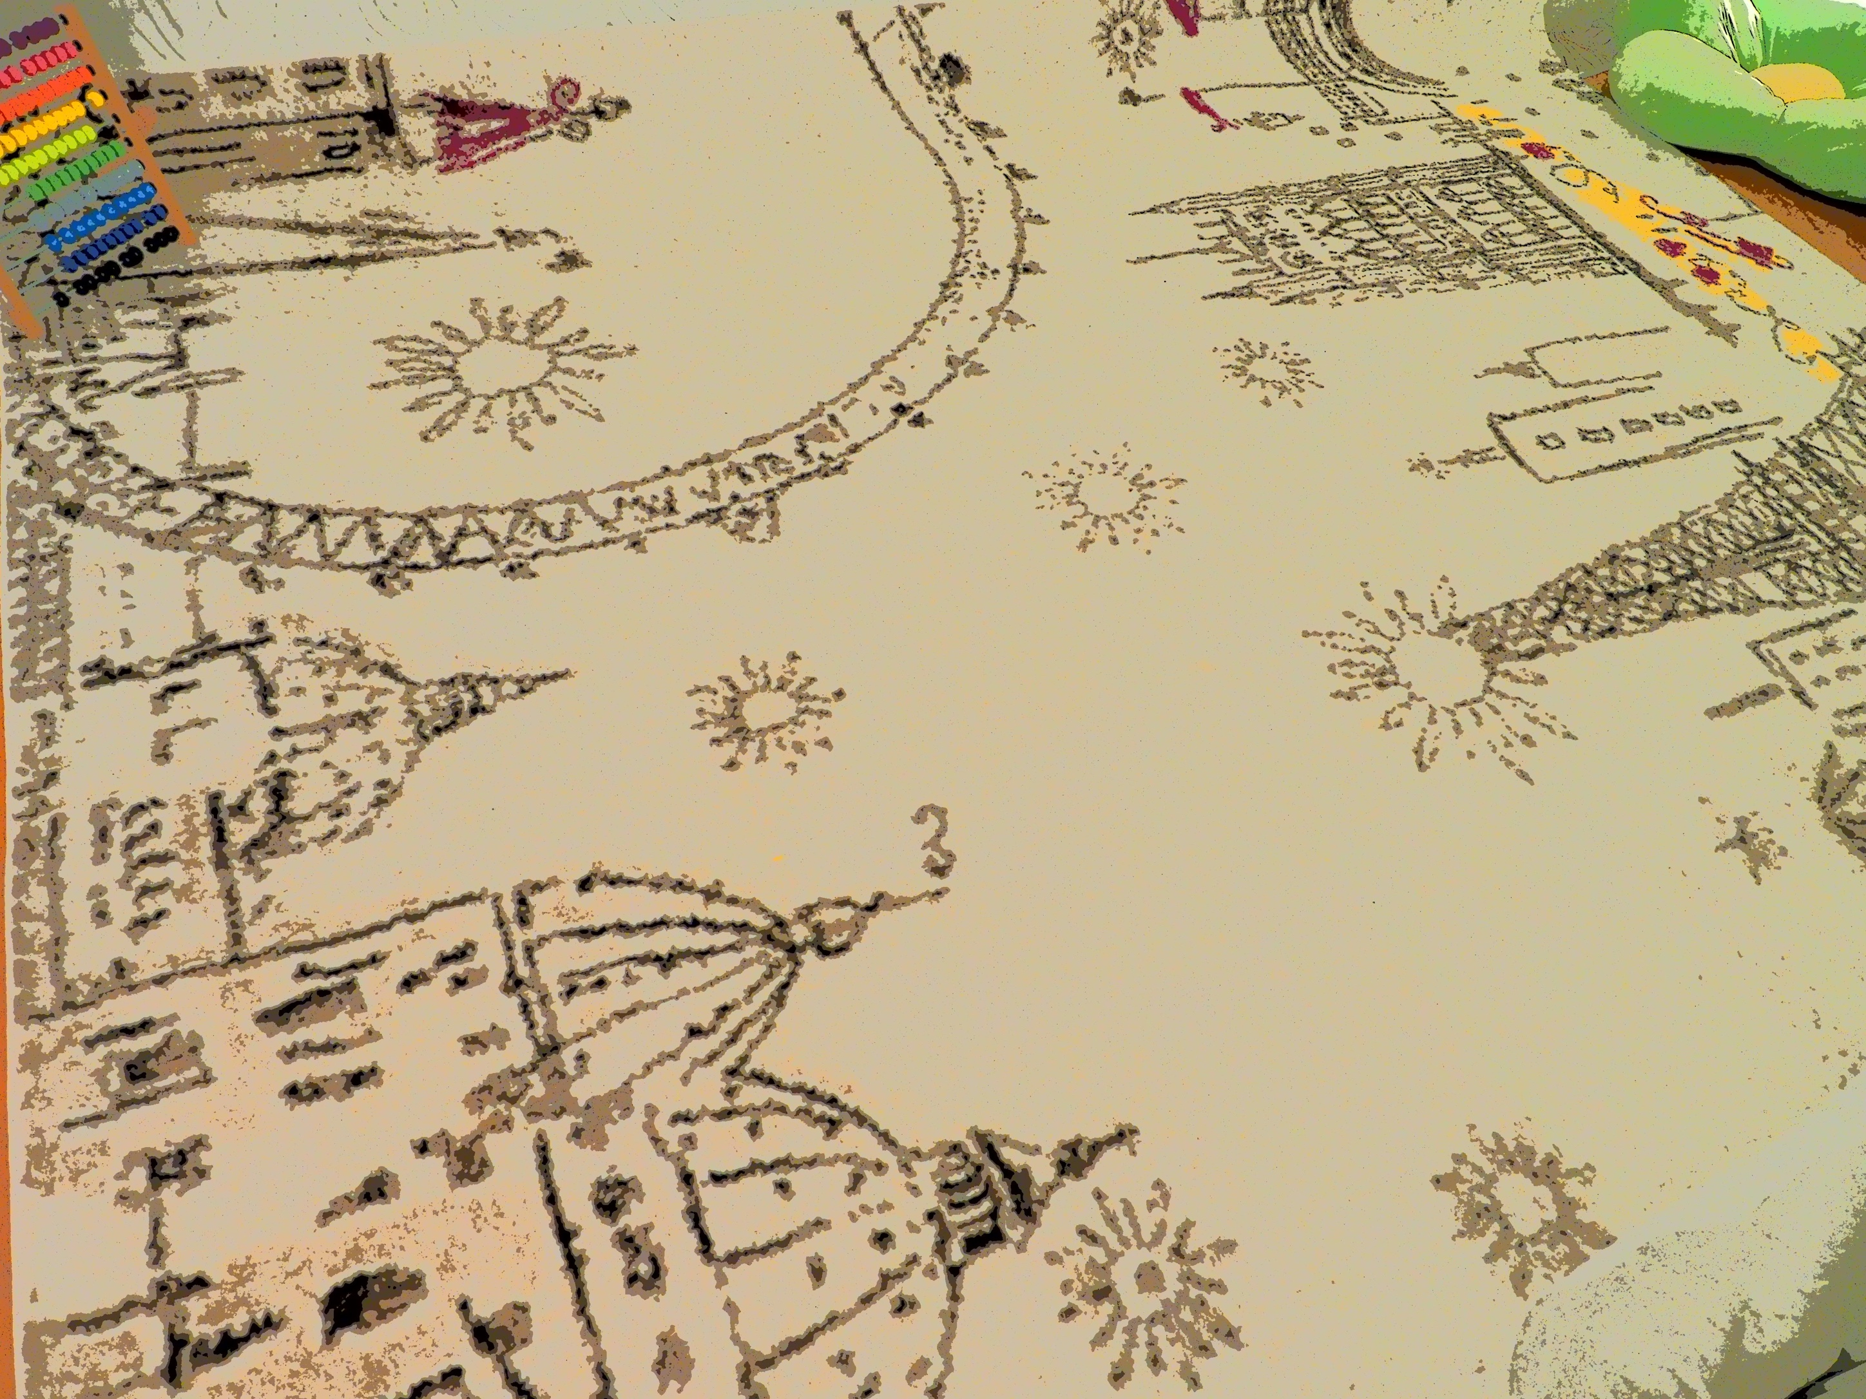
Collage

Slide 14
SPATIAL
MAPPING

Slide 15
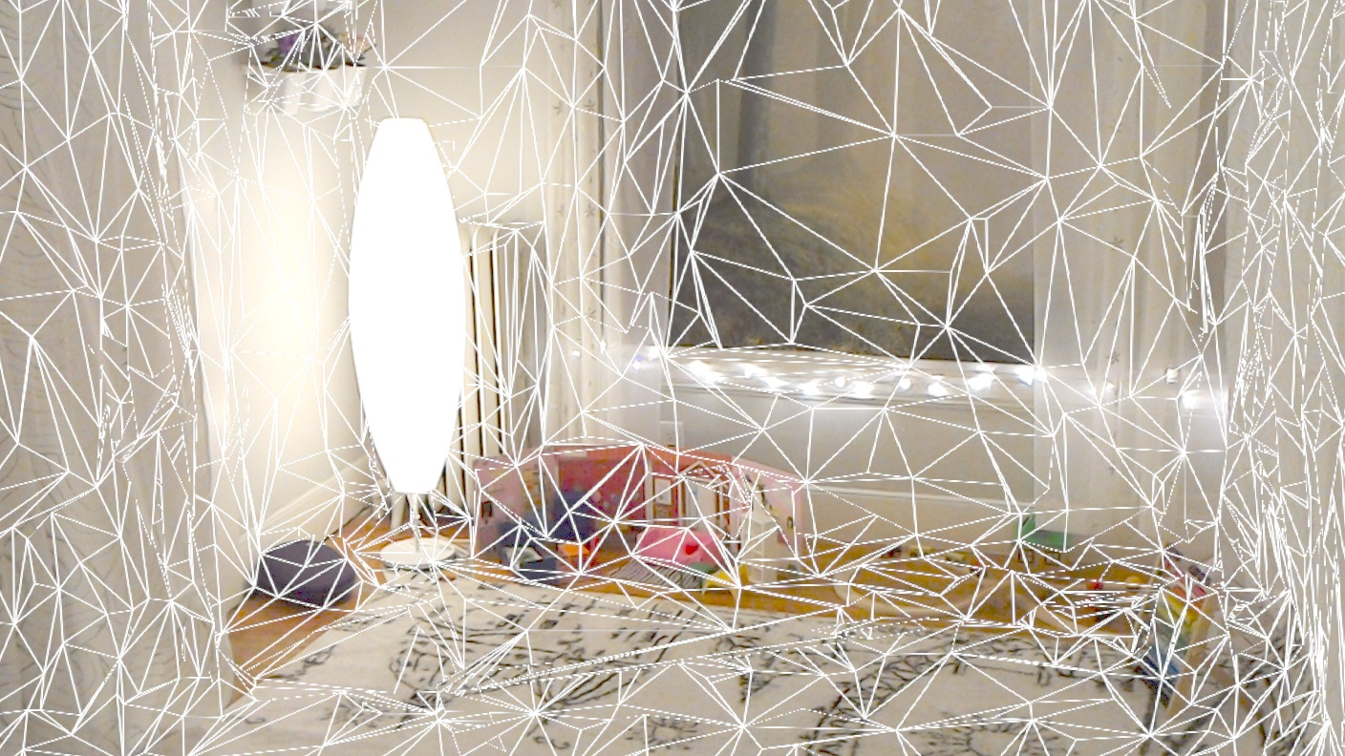
MESHES FOR OBJECTS

Slide 16
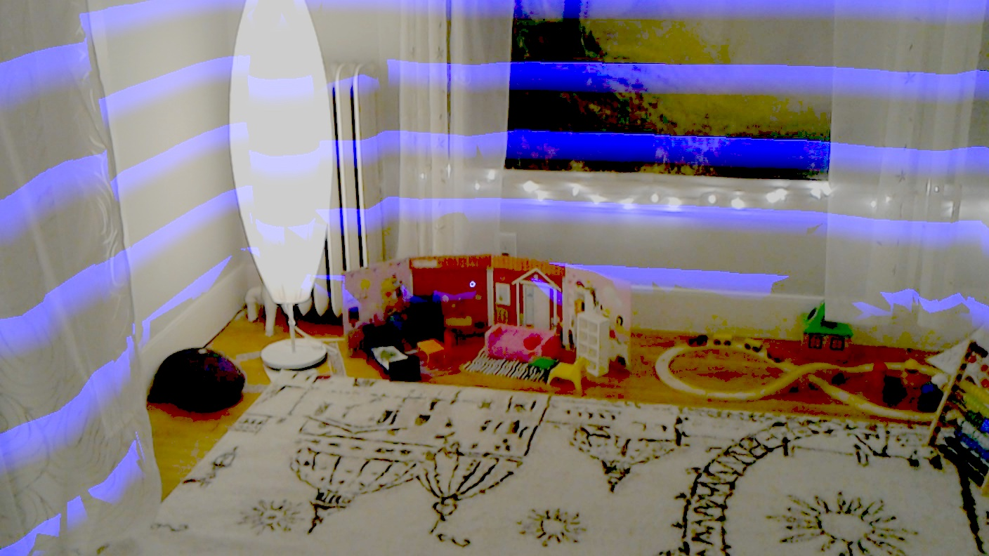
MAPPING WALLS

Slide 17
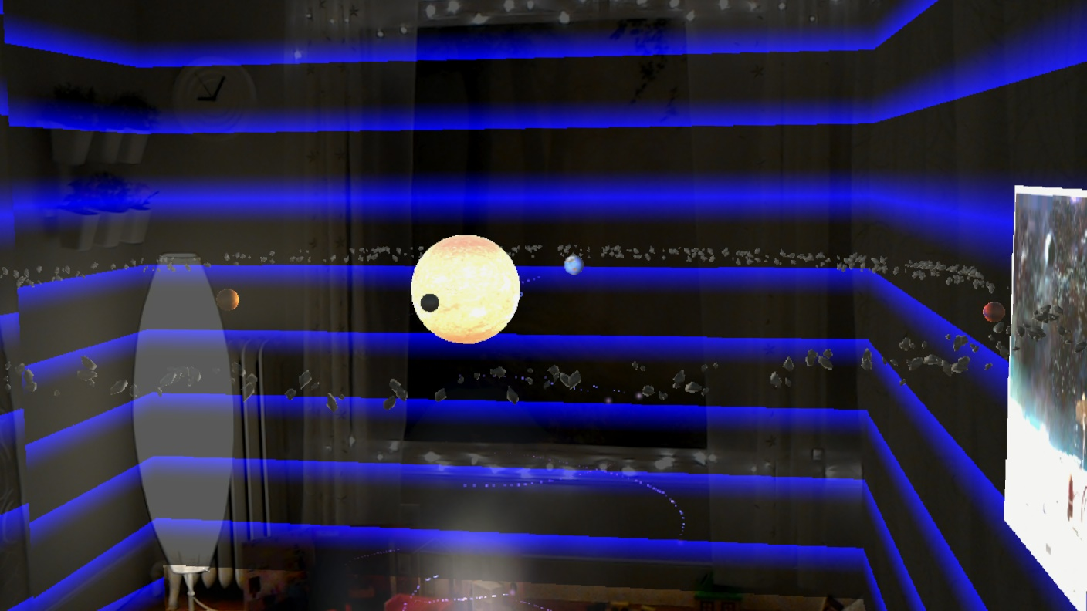
ADDING OBJECTS

Slide 18
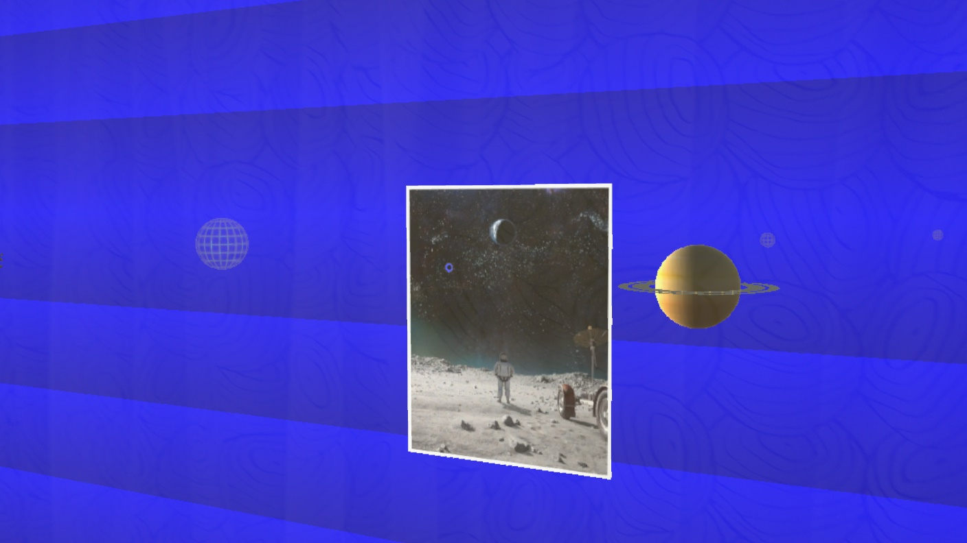
INTERACTING WITH WALLS

Slide 19
Thanks

